Slide 1
Precise Synchronization of Geographically Separate GNSS Dependent Time Providers
Ahmad Byagowi, Dotan Levi, Georgi Chalakov, Oleg Obleukhov, Michel Ouellette

Slide 2
Problem Formulation
It is challenging to extend precision synchronization dependent applications across the wide area network:
  PTP is designed for Local Area Networks
  Requires PTP compliant switches such as transparent clocks and boundary clocks
  Best master clock algorithm is used to form the synchronization topology tree
  Global navigational satellite system can provide a solution for synchronization across WAN with the cost of reliability
  Using atomic clocks, islands of synchronization (local area network) can exist without the notion of global synchronization
  A method is needed to constantly gauge and validate the global synchronization between the set of local area networks, equipped with PTP

Slide 3
Background
PTP takes advantage of:
  Hardware Timestamping
  Compliant Switches
  Higher message rates
These are not available/guaranteed across a wide area network
GNSS (GPS, BeiDou, GLONASS, GALILEO,…) are capable to deliver time
  Time of the day
  1 Pulse Per Second
Relying solely on GNSS carries risk
  It gets delivered via an antenna
  Local Holdover Oscillators/Clocks are Prone to Misalignment

Slide 4
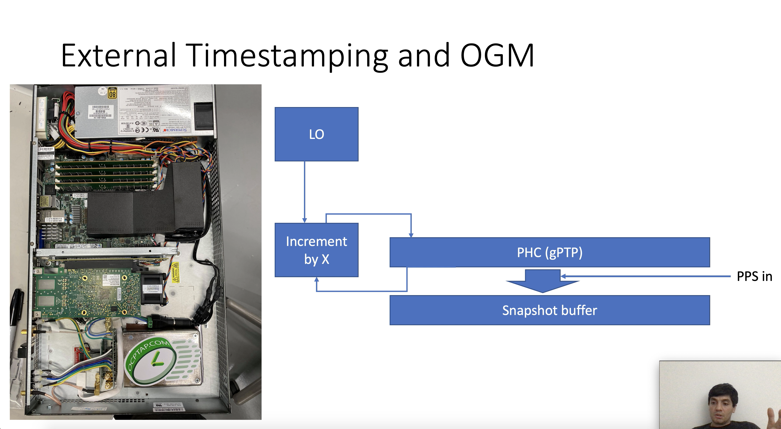


Slide 5
Cesium Clock based AFG
1 PPS out
Machine 2
PPS in
TC enabled switch
Open GM
Machine 3
PPS in
Machine 4
PPS in
Machine 5
PPS in
Machine 1
Machine 6
PPS in
Local Test Setup

Slide 6
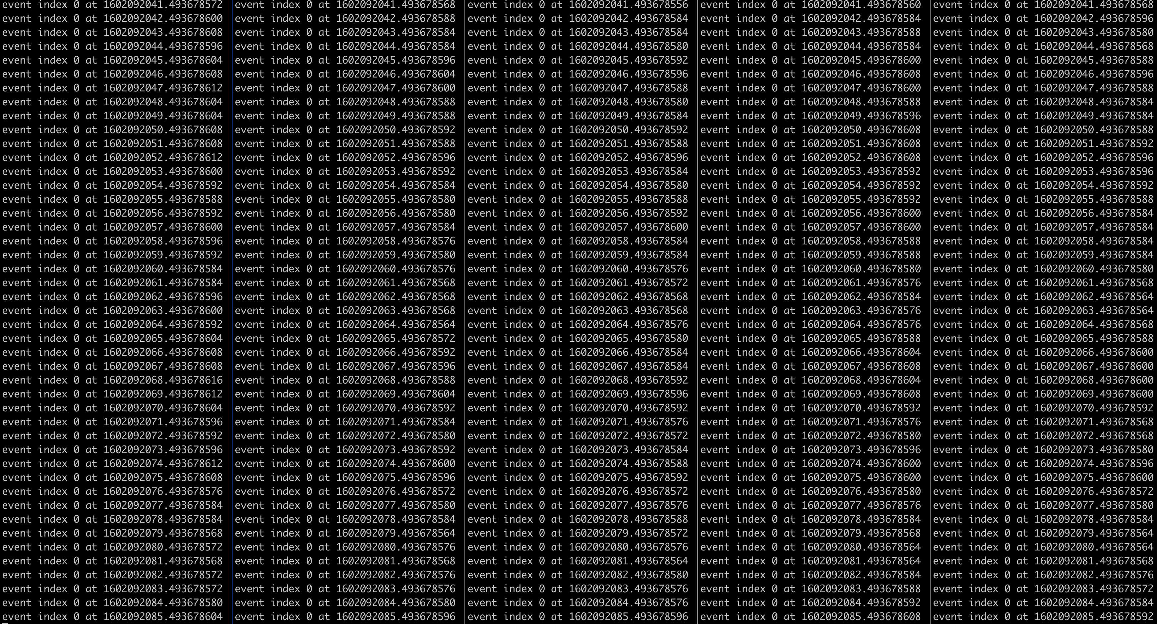
Time Stamps

Slide 7
Syntonization

Slide 8
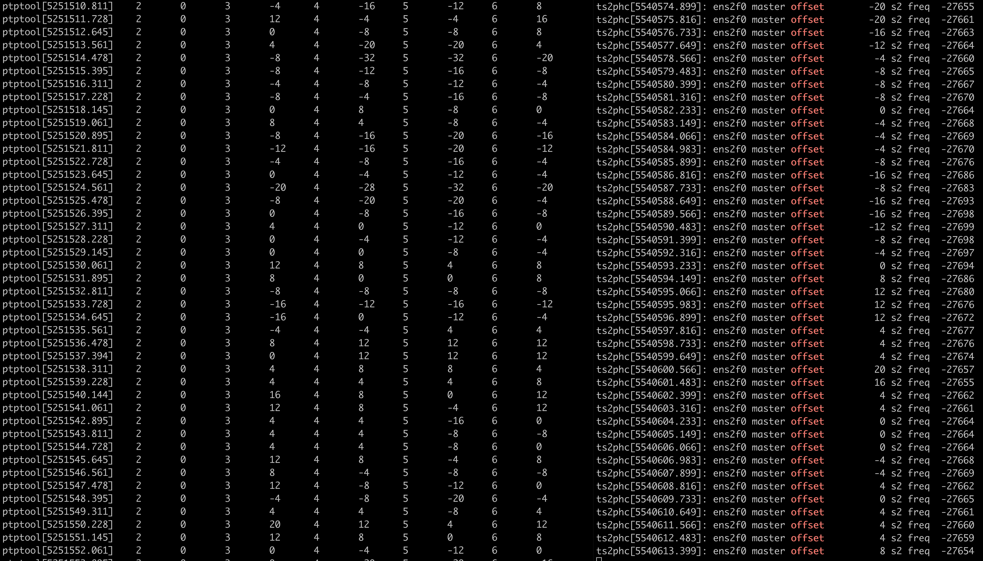
Synchronization

Slide 9
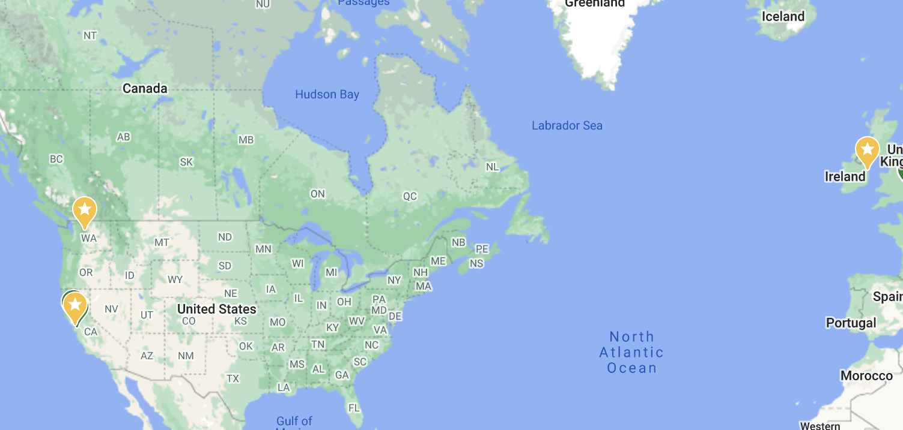

GNSS
PPS
Open GM
Machine C
GNSS
PTP
PPS
Open GM
Machine B
PTP
GNSS
PPS
Open GM
Machine A
VPN
PTP
Over WAN Setup

Slide 10
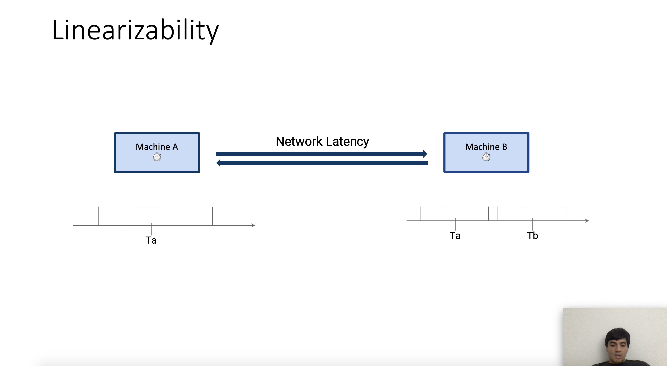

Slide 11
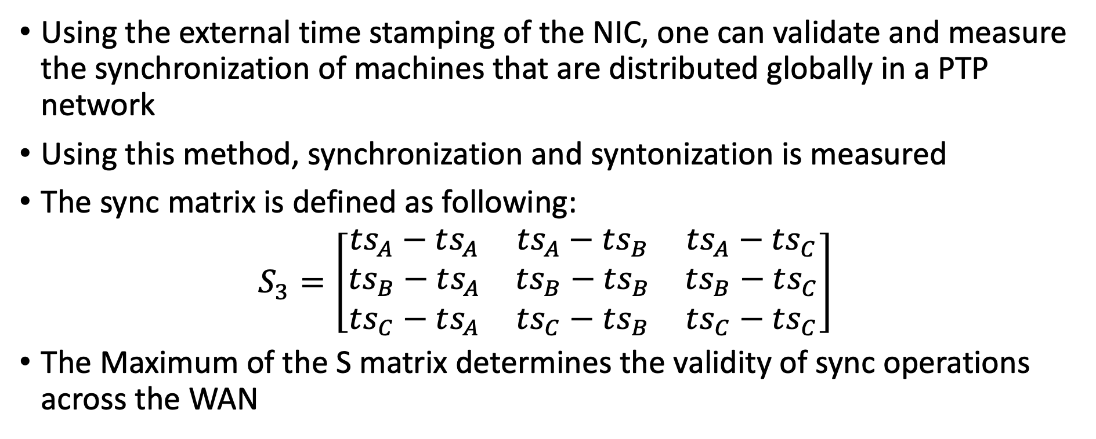
Discussion
Using the external time stamping of the NIC, one can validate and measure the synchronization of machines that are distributed globally in a PTP network
Using this method, synchronization and syntonization is measured
The sync matrix is defined as following:
$S_{3}=\left[\begin{matrix}ts_{A}−ts_{A} & ts_{A}−ts_{B} & ts_{A}−ts_{C} \\ ts_{B}−ts_{A} & ts_{B}−ts_{B} & ts_{B}−ts_{C} \\ ts_{C}−ts_{A} & ts_{C}−ts_{B} & ts_{C}−ts_{C}\end{matrix}\right]$
The Maximum of the S matrix determines the validity of sync operations across the WAN

Slide 12
Conclusion
Using the external time stamping of the NIC, one can measure the synchronization of machines in a PTP network
This method can be expanded to a wide area network
Using the Sync Matrix, the validity of synchronization can be verified. This is useful for the sync dependent applications
Various operations can be performed on the Sync Matrix in order to provide indicative scalar about the synchronization performance

